Slide 1

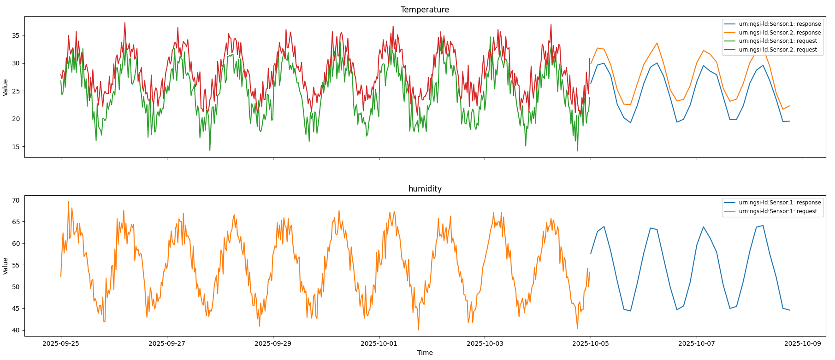
Time Series Forecasting service with Smart City Data from the Greek Smart Cities Ecosystem
Ioannis Tsampras, Tanya, Politi, Spyros Denazis University of Patras

Slide 2
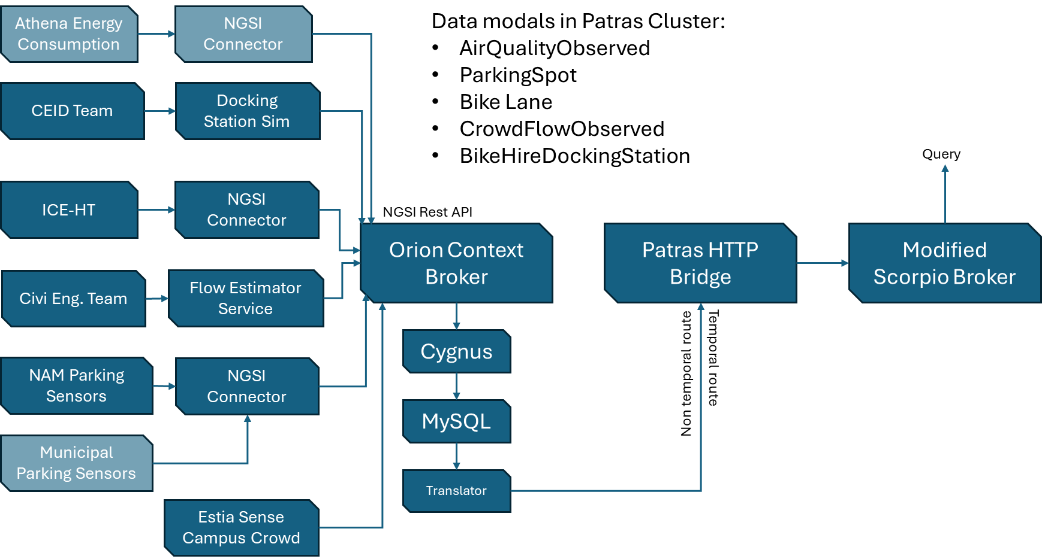
University of Patras Digital Infrastructure
The patras cluster sources and data

Slide 3
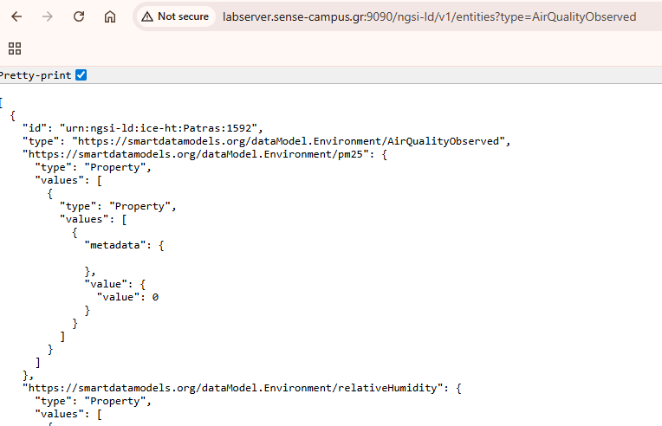
Let’s “Ping” Them !
In the urls.txt file you will find 4 URLs for temporal and non temporal queries of AirQualityObserved and CrowdFlowObserved entities.
Clone the repository
https://github.com/Skorpinakos/ISC2-2025-Patras-Tutorial

Slide 4
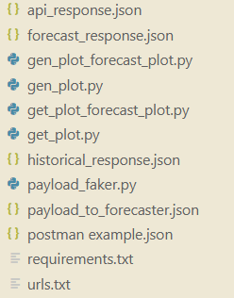
Requirements
You will need Python 3 and:
requests
pandas
Matplotlib
You can use pip install –r requirements.txt

Slide 5
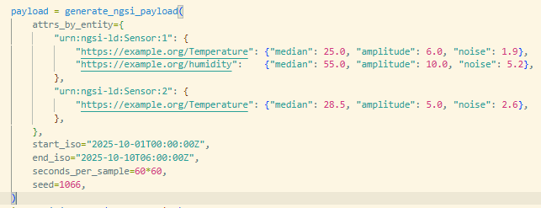
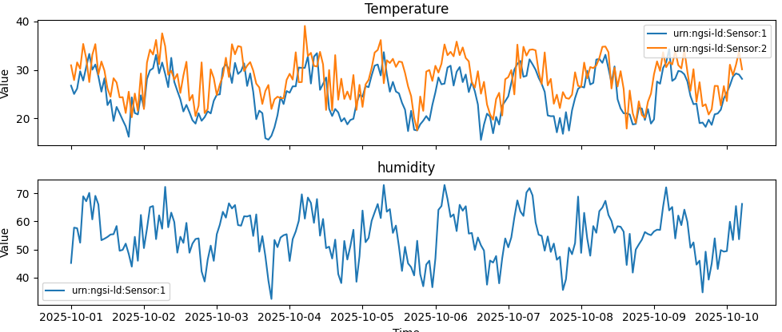
Generating Fake Data
To test the forecasting service, we will generate fake data for the request payload.
The generator uses daily periods to create data
The data should hide periodical patterns for the forecaster to detect and noise to test its reliability.

Slide 6
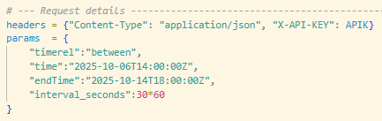
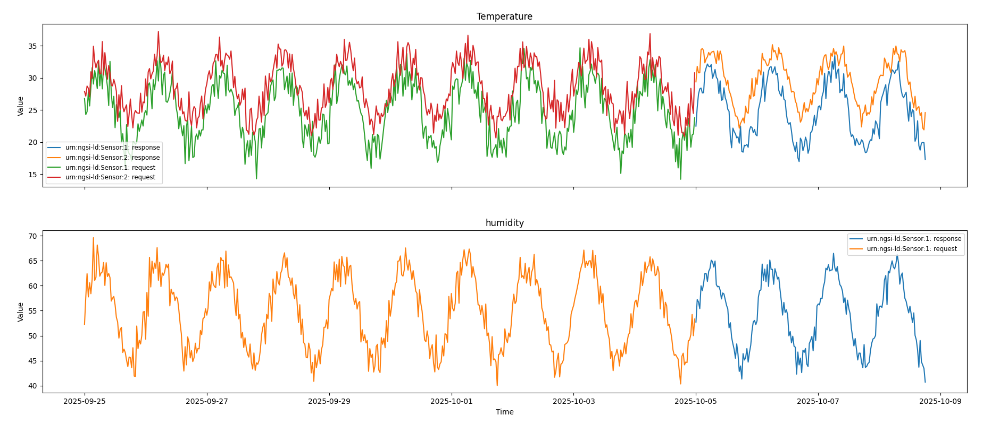
Forecasting from Fake Data
We send the “NGSI-LD Temporal” formatted payload to the forecasting service and fetch the response.
We can select the resolution we want for the forecast, or the service will snap to a common sampling period close to the training data average
We can select the resolution we want for our forecast
30min
3h

Slide 7
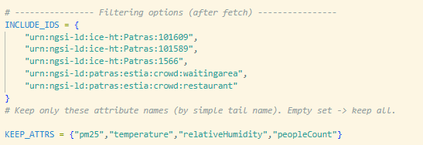
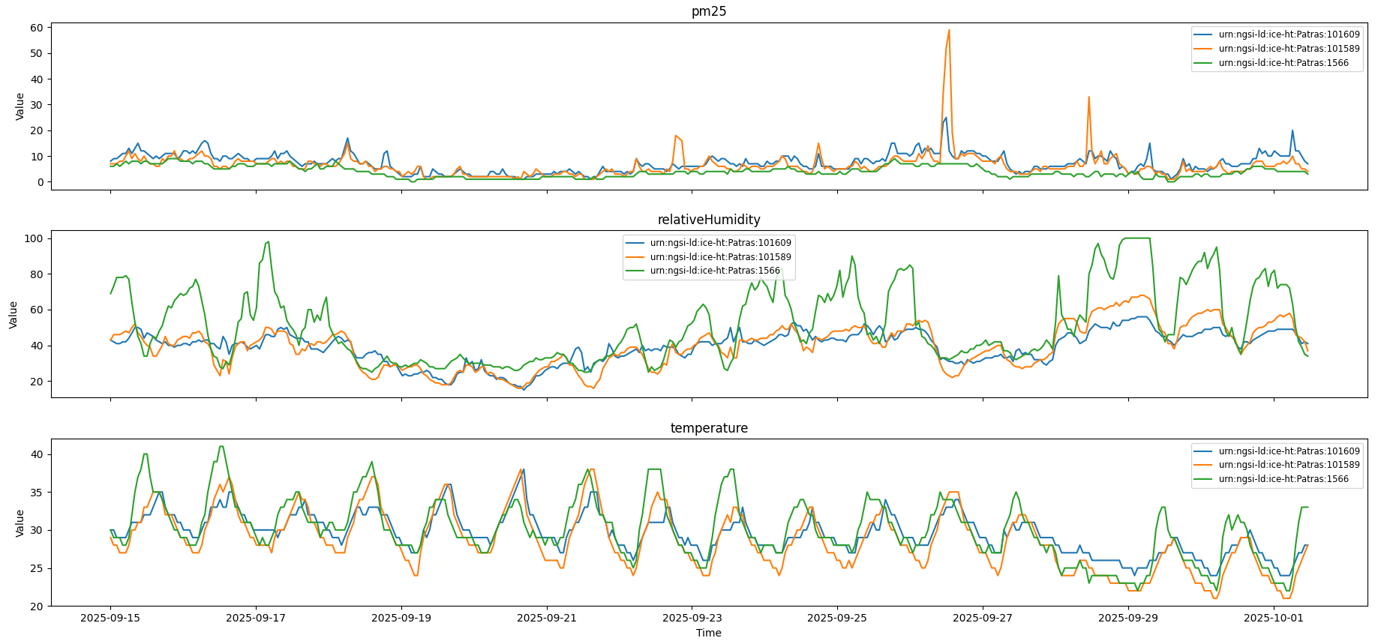
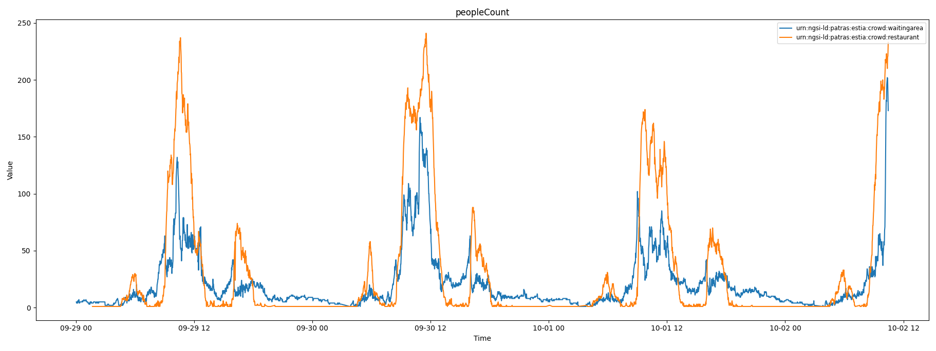
Visualizing Real Data
We request one of the URLs and store the json response.
We filter the results to accept only some of the entities for this tutorial and only attributes of numeric nature (although the forecaster can accept anything)
Real Data from 3 AQ stations in Patras
Real Data from restaurant occupancy and waiting line in Univ. of Patras

Slide 8
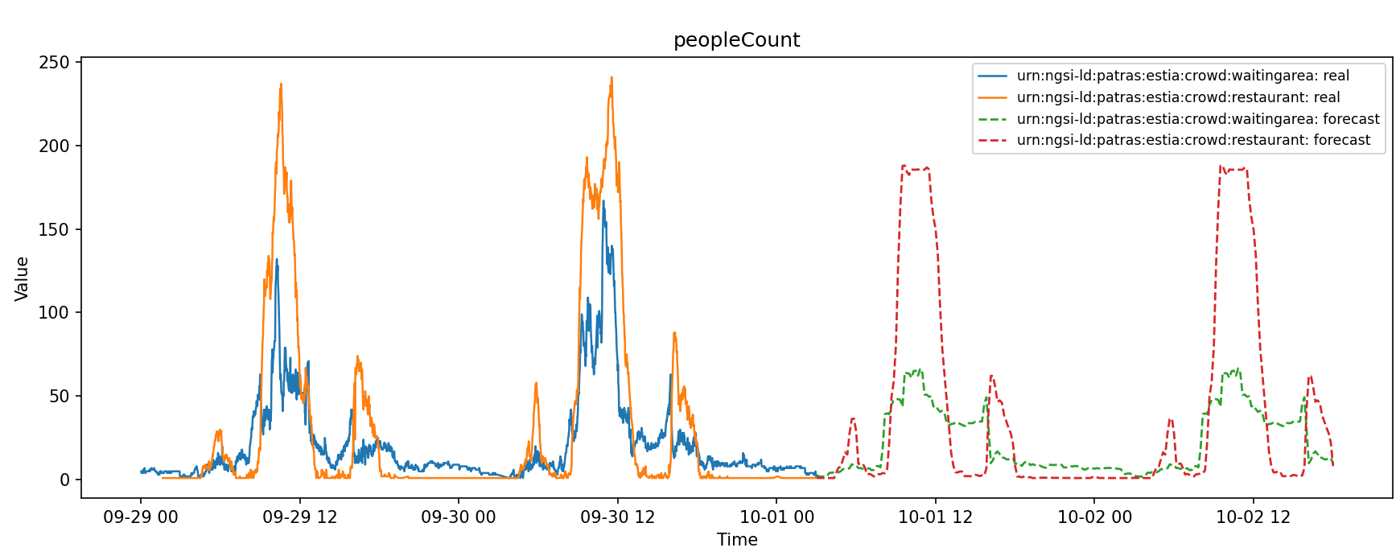
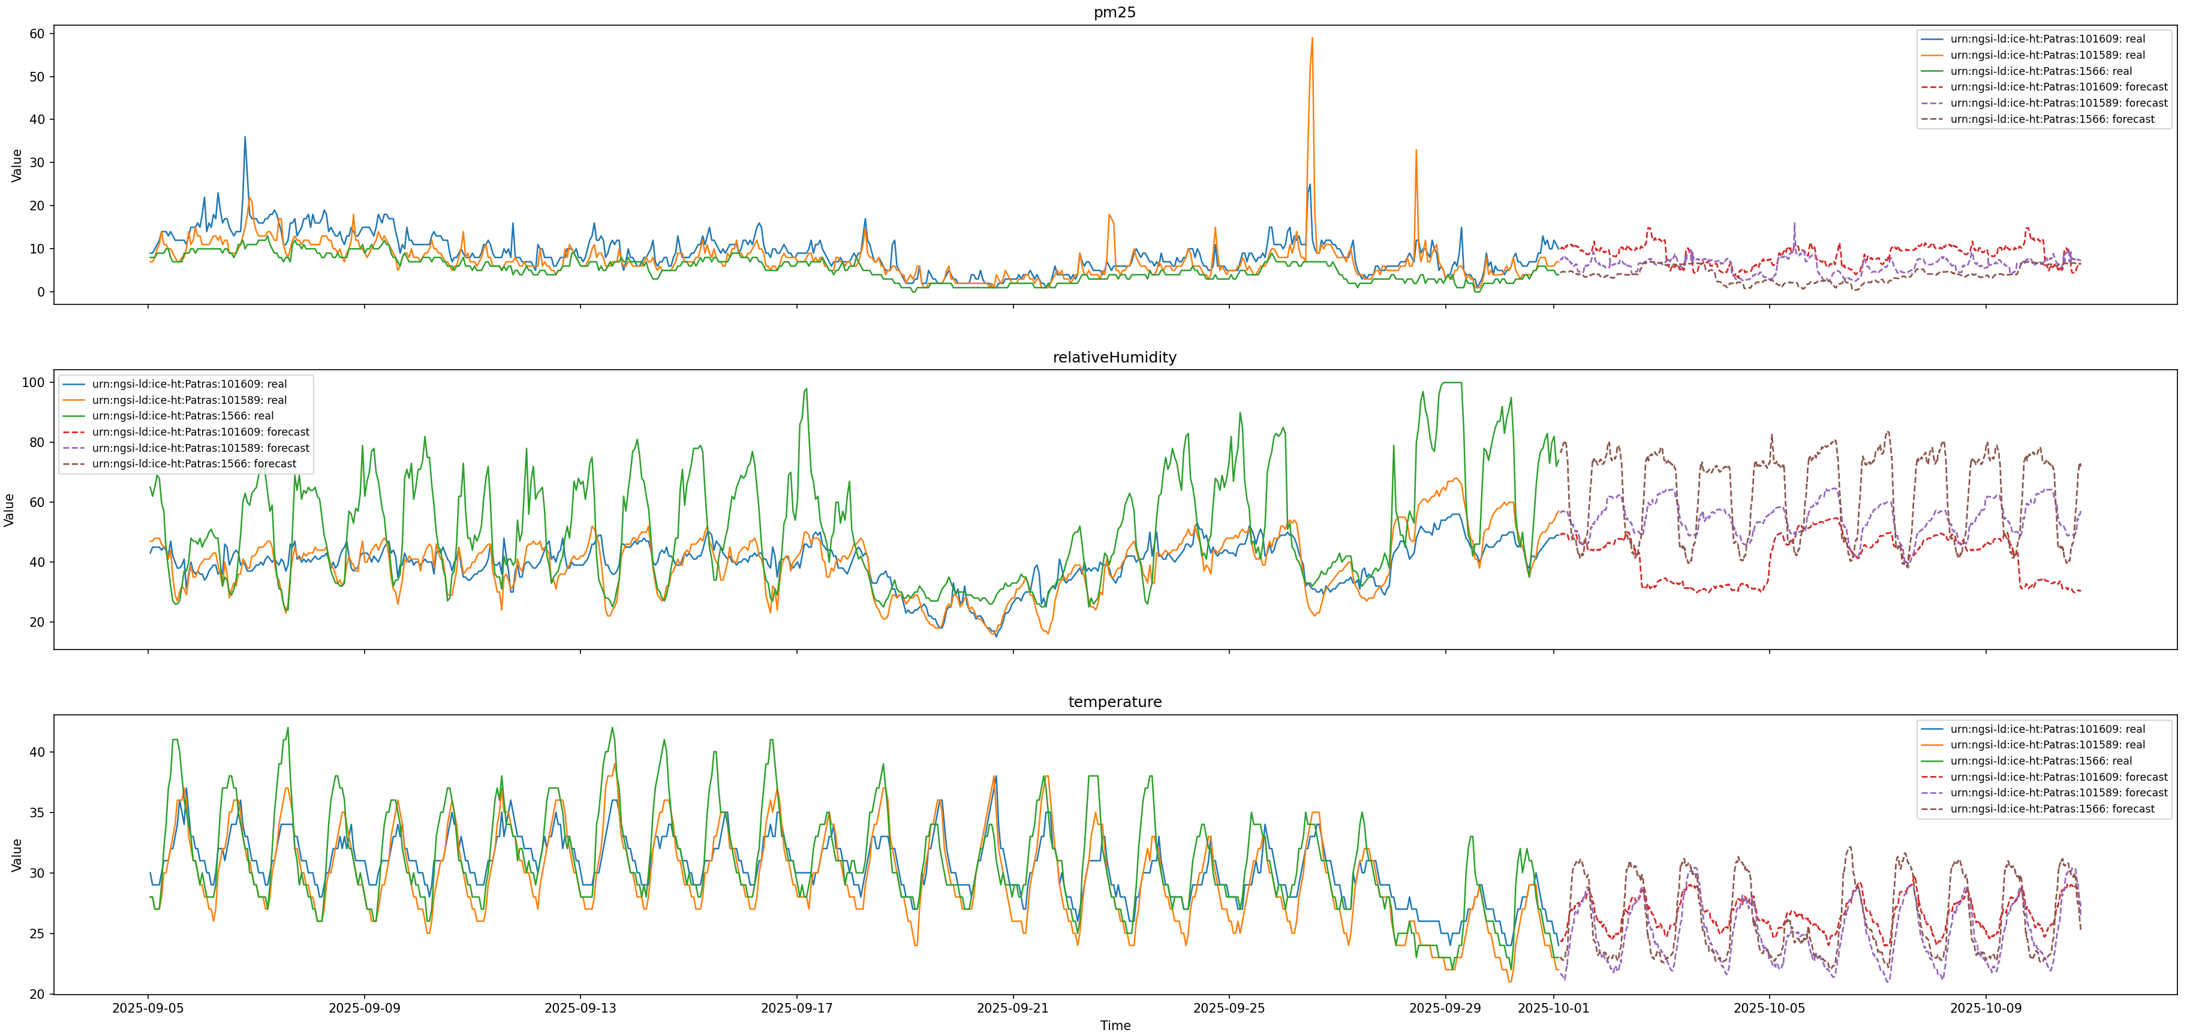
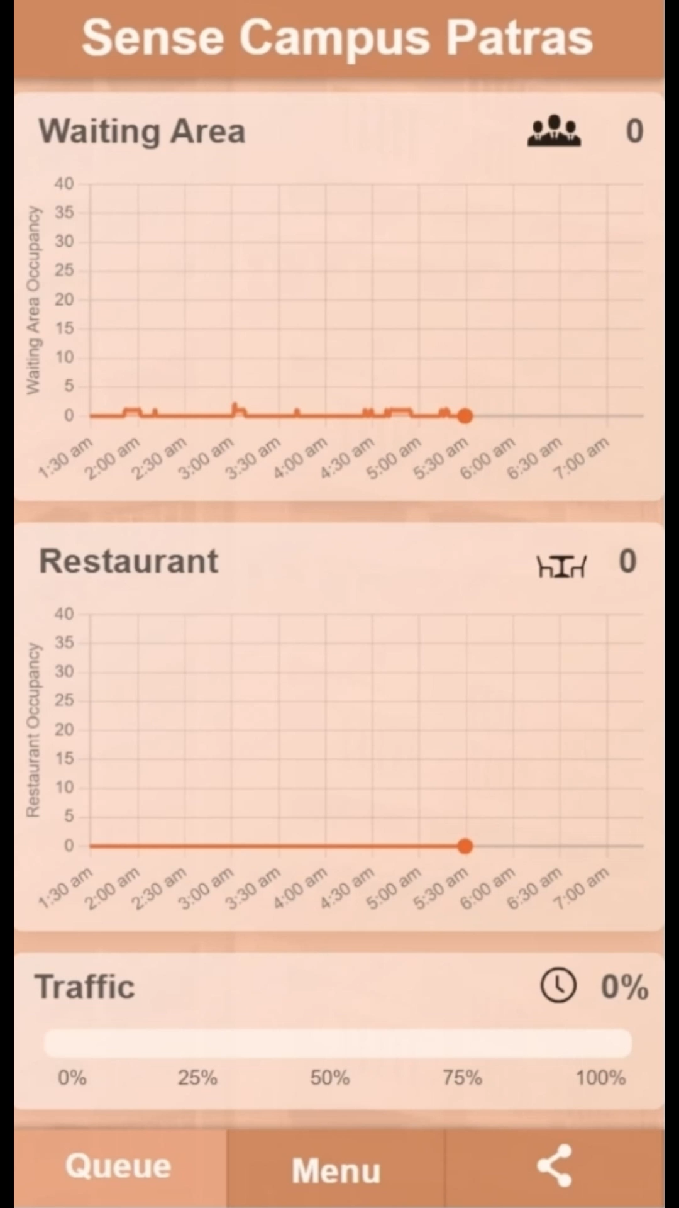
Forecasting Real Data
We filter the results to accept only some of the entities for this tutorial and only attributes of numeric nature (although the forecaster can accept anything)
We request one of the URLs and store the json response.

